Slide 1

Introducing an inclusive procurement strategy
With thanks to for providing the content

Slide 2
Megatrends will define and shape our world and therefore the business environment
Understanding and addressing them is key the future success of any business.

Slide 3

What are megatrends?
A megatrend is a large, social, economic, political, environmental or technological change that is slow
to form.
Once in place, megatrends influence a wide range of activities, processes and perceptions, both in government and in society, possibly for decades.
Notes:
Information source : http://ssl.csg.org/Trends/Megatrends%20Definitions%20and%20Categories.pdf
Image source: http://teachwilsonteach.cmswiki.wikispaces.net/Why+Study+Social+Studies

Slide 4















Disability is a megatrend
According to the World Health Organisation there are over 1 billion people with disabilities.
Our business strategies must include them.

Slide 5

We face a demographic time bomb
Western populations are ageing, improvements in healthcare are helping people live longer – so more will need assistance coping with age related conditions.
There are likely to be ever increasing numbers of people with poor vision, hearing loss, limited mobility and cognitive difficulties.
We need to ensure that they are not excluded.

Slide 6
Often megatrends are interlinked
Megatrends are too big
to ignore
Migration
Disability
Mobile and virtual computing
Literacy and education
Aging populations
Population growth

Slide 7
An inclusive IT strategy meets these needs:
It’s more than just accessibility and Assistive Tech
Assistive Technology (AT) is an umbrella term that includes assistive, adaptive, and rehabilitative devices & software for people with disabilities.
We need to widen the definition to include:
  Usability
  Interoperability
  User experience

Slide 8
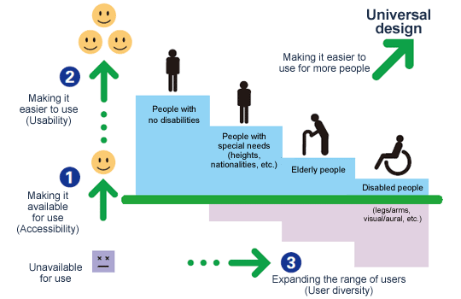
Inclusive IT follows universal design principles
Notes:
This Example is from Fuji Xerox

Slide 9
Inclusive IT is good business! Procurement is key
An inclusive procurement policy:
Reduces risk
Reduces costs
Results in an improved user experience
Widens the potential customer base
Creates market demand for more accessible products
Fits the Corporate Social Responsibility (CSR) agenda
Notes:
By offering Accessibility

Slide 10
There are lots of benefits
Commercial benefits
Innovation,
ease of use
and accessibility business case
Legal benefits
Social
/ moral benefits
Notes:
Source University Of Southampton

Slide 11
Not planning for inclusion costs us dear!
Planned inclusive design pays dividends
Inclusive design as an afterthought
Inclusive design from half way
Inclusive design from inception

Slide 12
Procurement is the gateway to inclusion
Inclusive technology (accessibility and usability) is all pervasive.
In order to provide inclusive IT systems, first we need to include accessibility in our design process.
We then need to select and procure products that are as accessible as possible.
Clients
Bids & Solutions
Inclusive IT
Procurement
Service Management
Integration & Delivery
Support Services

Slide 13
An example of why an organisation needed to have an accessible procurement policy
The problem
A key project worth millions of pounds for a major media client was identified as being at risk of being rejected on the grounds of inaccessibility.
The product at the heart of the project was part of a “Core Toolset” procured centrally.
Their testing indicated major accessibility failings.
The vendor was insistent that the product was accessible because it had an accessibility statement (VPAT).
It required the involvement of strategic procurement to open negotiations at a senior level.

Slide 14
An example of why an organisation needed to have an accessible procurement policy
The solution
Procurement hold the purse strings.
Through procurement, they were able to gain access to senior management.
Demonstration of the issues.
Frank and open discussions about the limitations of the technologies (both the AT & the vendor’s product).
Some issues were accepted as bugs and fixed free of charge.
Other issues were agreed as enhancements.
A joint roadmap detailing accessibility improvements was produced, that enabled them to gain acceptance of the project from their customer.

Slide 15
Our commitment is
To buy ICT systems that not only comply with relevant accessibility standards but also consider usability, interoperability and user experience.
To exceed our legal obligations, enabling us to access talent from the widest possible pool. This will enhance productivity generally, while welcoming and enabling access for millions of customers worldwide.
To ensure ease of use by people with varying capabilities, including, but not only, users of a range of assistive technologies.
To position accessibility as a fundamental and integral aspect of all our ICT systems and related services. We are therefore making accessibility, and accessibility competence, a mandatory consideration in the specifications of all the ICT products and services we purchase and deliver.

Slide 16
  Our call to action:
  A measure of accessibility
All products and systems developed by or supplied to us must have interfaces and generate content that can be tested and demonstrated to be perceivable, operable, understandable and robust.
We will measure and test these against external guidelines agreed as relevant to the technology or system by individual end users.
We realise that mere standards compliance is unlikely to deliver real accessibility, and will seek to embed best and improving practice in our use of technology.
We will ensure user consultation and testing is recognised as a critical enabler of real-world accessibility.

Slide 17
What these measures mean
As far as possible every ICT product, service or system should:
Be technically accessible, in that it is possible for all users to access information and functionality.
Be equally usable, in that it is not prohibitively difficult or time consuming for users with disabilities to carry out normal tasks.
Be capable of being adapted or configured by individual users to meet their specific needs and preferences.
Be capable of interfacing with appropriate, widely available assistive technologies employed by users.

Slide 18
Assume that everything is in scope
Our commitment applies to all ICT products, services and systems purchased, developed, supplied or otherwise procured by us or on our behalf.
It applies equally to the processes enabled by those products, services and systems and to materials supporting them e.g. error messages, system help tutorials, help desks and user guides.
This is hugely ambitious and a significant undertaking when you are an IT company or an organisation that is totally reliant on IT, like ones in the banking sector.

Slide 19
This change will not happen over night
It is a long term commitment to work with suppliers to:
Create a portfolio of accessible products
Hold regular meetings to assess progress
Where products are not currently accessible
  Develop roadmaps to achieve accessibility
  Include accessibility in future versions
  Understand how new technologies may affect future accessibility and usability of systems and processes

