Slide 1
What disabled consumers choose to buy and why – Utilities

Slide 2
Spending power of disabled consumers
In the UK, it’s thought that some seven million people of working age have a disability. ​
They have a spending power, known as the "purple pound" worth around £274bn, and they want to make sure they choose the right utilities providers. ​
With consumers paying more attention than ever to their utility providers, now is the time to make sure you are attracting disabled consumers.

Slide 3
Product information is key
Disabled consumers want to know how they will set up, manage, and switch accounts before they buy.
Key factors influencing the decision of provider include:
Details about the account and ensuring it met the consumer’s requirements (55 per cent)
The process and ease of setting up the account (49 per cent)
Accessibility of the website or app (46 per cent).
“I had two companies in mind as a result of talking to friends and reading reviews. The one that won was more accessible with an easier to use website and app.”

Slide 4
But it isn’t always easy to find
However, 62 per cent said that finding and accessing the information they needed was more challenging because of their disability.
“For gas/electricity, it has proven very difficult to get info on whether smart meters are accessible or whether there is a workaround. The providers often either don't know or find it difficult to get information to me.”
“Because it was not easily available, information about the access services they provide, there was no way of knowing without signing up if their app was screen-reader friendly. It took a very, very, long time to get through to customer services on the phone.”

Slide 5
Consumers need informed and helpful support staff
Disabled consumers wanted to know that they would be able to get through to customer support staff, and that when they did, the staff would be able to meet their specific needs.
41 per cent of respondents said that ‘confidence in how customer services and support would work’ influenced their decision of utilities providers.

Slide 6
Inclusive communication
Disabled consumers want to be able to communicate with and receive communications from their utilities provider in a way that suits them.
45 per cent said that they looked for utilities providers that offer a range of contact options.
Providers also need to recognise how disability can affect how a consumer is able to communicate with them.
“They wanted a phone conversation. I am deaf.”
Deaf consumer

Slide 7
Getting it right – Disability awareness
Respondents praised utilities providers who demonstrated an awareness of disability and how it affected the ways in which consumers interact with their services.
“The ability to communicate with a person and not having to do everything online. Access to warm home discount. Disability awareness within the company so operatives coming to the house would be aware. Priority if there was an emergency.”

Slide 8
Getting it right – Accessibility
Respondents also rewarded providers that showed they had considered disability and accessibility when designing websites and apps.
“I had two companies in mind as a result of talking to friends and reading reviews. The one that won was more accessible with an easier to use website and app.”

Slide 9
Getting it right – Communication and customer service
Often the issue was not with providing the services that disabled consumers needed, but with this information not being shared with consumers.
“We went with the supplier who was clear and confident about their provision for disabled people. They actually prioritise our street now in the event of a power cut and this is a relief to know, apparently all providers do this, but the issue is none of the others were confident to say that!”
“We have broadband and mobiles with [the same provider], although they are not cheapest, but we know their customer service is good. They are kind and consider my disability.”

Slide 10
Key recommendations – Provide detailed information
Provide clear, accessible and easy to read information about how to set up and manage accounts.
Make sure that consumers are reassured about the accessibility and usability of websites and apps before they sign up.
Avoid using jargon and make sure that language in documents about policies and costs is easy to understand.

Slide 11
Key recommendations – Customer service support
Allow disabled consumers to communicate with customer service teams in the formats that they can use and prefer.
Providing multiple contact options avoids unpleasant situations, such as requiring a deaf consumer having to make a phone call.
If the utility provider has a dedicated teams for disabled consumers who are able to answer disability specific questions, signpost them clearly so disabled consumers know how to contact the team.

Slide 12
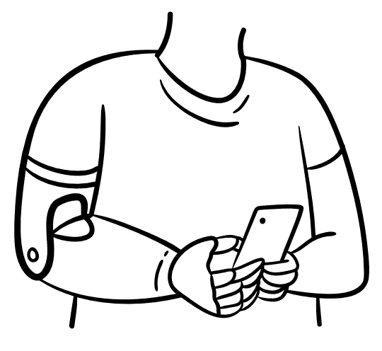
Key recommendations – Accessibility
Make sure that websites and apps that consumers use to research, sign up, manage and switch accounts are fully accessible.
Provide alternatives for managing accounts – for example if meter reading poses a barrier – that are accessible and usable for the consumer.

Slide 13
Conclusion
Disabled consumers’ experience of utility providers is often poor.
Accessing and managing utilities accounts is crucial for all consumers, but disabled consumers in particular can find this difficult due to problems with accessibility, inclusive communication and customer service support.
There is a real opportunity for utility providers to make sure that disabled consumers are receiving high quality customer services for the utilities services that they need.

Slide 14
About Business Disability Forum
Business Disability Forum is the leading business membership organisation in disability inclusion. We are trusted partners, working with business, Government and disabled people to improve the life experiences of disabled employees and consumers, by removing barriers to inclusion.
Find out more about the benefits of joining us at businessdisabilityforum.org.uk/membership.

Slide 15
Contact us
enquiries@businessdisabilityforum.org.uk
+44-(0)20-7403-3020

