Slide 1
The Accessibility Business Case
Created by Business Disability Forum’s Technology Taskforce
Notes:
Today, we will be talking about the business case for accessibility.

Slide 2
Introduction to the Accessibility Business Case (ABC)
The five key themes for success
Evidence based
What next?
Notes:
The Accessibility Business Case, or the ABC for short, is made up of five keys themes.
In this presentation, we will explain the five key themes, the evidence to support them, and what you can do next to make accessibility a reality in your organisation.

Slide 3
Five themes of the ABC
Innovation
Inclusion
Brand
Productivity
Compliance
Diverse ideas create new opportunities
Inclusive design leaves no one behind
An inclusive brand outperforms
Accessible solutions boost productivity for everyone
Raising the bar reduces the risks
Notes:
Fives themes of the ABC
Business Disability Forum’s Technology Taskforce have pulled together five themes on why accessibility is critical to your business. These are based on their insider knowledge and experience of what has worked for them.
We will talk you through each of these themes, with evidence to support the claims, in a bit more detail.
This slide can also be used on its own with the following “elevator speech”:
“Without accessibility you are excluding people with disabilities, the largest minority group in the world that anyone can join at any time. This will impact your brand, productivity and compliance. Companies that are intentional about accessibility have tapped into a talent pool that sparks innovation; develop products and services that are inclusive by design; improve customer engagement; increase revenue and reduce the risk of litigation. In short, accessibility is the right thing to do for everyone.”

Slide 4
Innovation
Innovation
Diverse ideas create new opportunities
Notes:
Our first theme is innovation.
Diverse ideas create new opportunities.

Slide 5
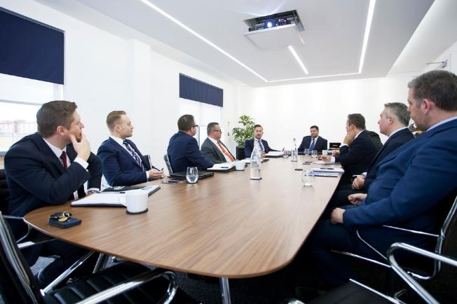
Innovation starts with people…
These important people are discussing innovation. What are their chances of coming up with something new?
Notes:
Innovation starts with people
These important people are discussing innovation. A rhetorical question: Given the lack of diversity in this group, what are the chance of new ideas being proposed that meet the needs of different people?

Slide 6
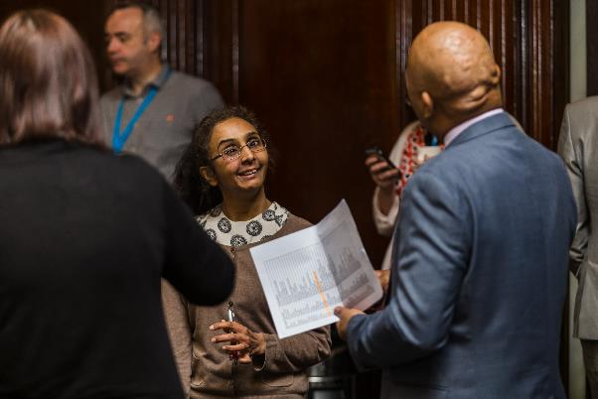
The best ideas come from diversity
Tapping into the talent of disabled people opens the conversation to different approaches and design thinking
Notes:
The best ideas come from diversity.
Tapping into the talent of disabled people opens the conversation to different approaches and design thinking. It stands to reason and has been proven in many types of research that diverse and inclusive teams are the most innovative.
When this is specific to disability inclusion we gain insights from people with different experiences, approaches, and ways of thinking. Many disabled people have become natural problem solvers due to a necessity borne out of working around barriers.
Also, people who have faced adversity have often developed greater empathy which is critical to design thinking.

Slide 7
Accessible design for all
Examples of how designing for one extends to many.
Typewriter or keyboard
Closed Captions
Ramps & kerb cuts
The bendy straw
Notes:
Accessible design for all
Here are some examples of how designing for one extends to many:
- 1808: The first typewriter was built by Pellegrino Turri. He was inspired by his affection for the Contessa Fantoni, a childhood friend in the early stages of blindness. This means the first version of the keyboard we all use was originally designed for people who are blind.
- 1960: Closed captions were invented for the deaf community. But did you know that 80 per cent of people using captions today do not have hearing loss or any form of deafness.
- 1937: The ‘bendy straw’ was invented by Joseph Friedman after watching his disabled daughter, who had restricted mobility, struggling to use a straight straw.

Slide 8
Inclusion
Inclusion
Inclusive design leaves no one behind.
Notes:
Our second theme is inclusion.
Inclusive design leaves no one behind.

Slide 9
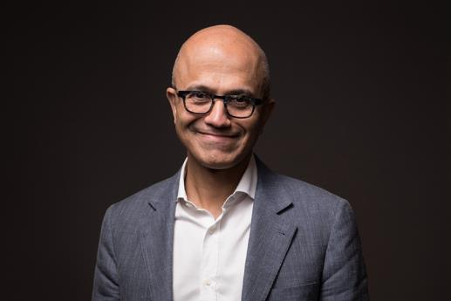
What top leaders say…
“Teams that value diverse perspectives and inclusive design principles will have the deepest impact in designing products for everyone”
(Satya Nadella, CEO, Microsoft)
Notes:
What top leaders say
This is a quote from Satya Nadella, CEO of Microsoft:
“Teams that value diverse perspectives and inclusive design principles will have the deepest impact in designing products for everyone.”

Slide 10
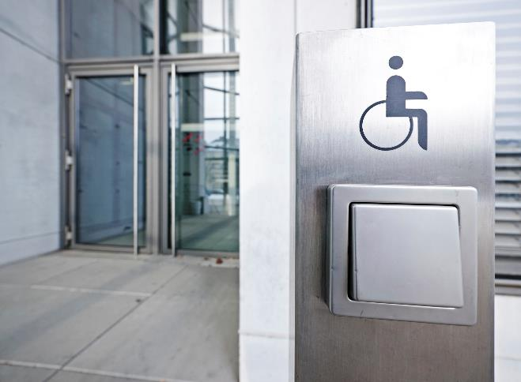
Be accessible throughout your employee journey
Notes:
Be accessible throughout your employee journey.
Your career and recruitment web pages should always be given priority when it comes to accessibility.
Don’t lose the best talent simply because the recruitment process was too difficult to access. Over 80 per cent of disabilities are acquired during our working lives so taking a proactive stance and making your environment accessible means you keep hold of employees.
Accessibility creates a sense of belonging.

Slide 11
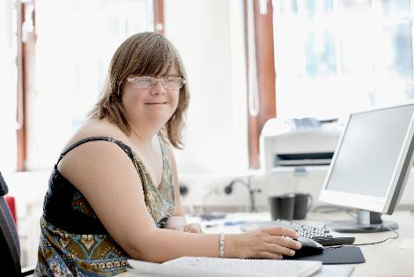
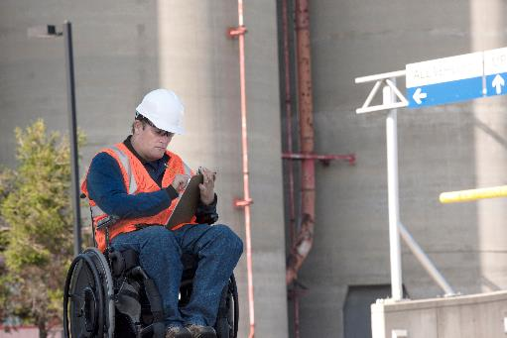
Reflect the customers you serve
Notes:
Reflect the customers you serve.
Having disabled employees means you reflect the reality of your customers and therefore create products, services, and solutions with them in mind.
Where possible, include customers in the design of new products and services as early as possible.

Slide 12
Brand
Brand
An inclusive brand outperforms
Notes:
Our third theme is brand.
An inclusive brand outperforms.

Slide 13
Be open and flexible
Notes:
Be open and flexible.
Offering different ways to interact with your customers and providing feedback loops demonstrates you care.

Slide 14
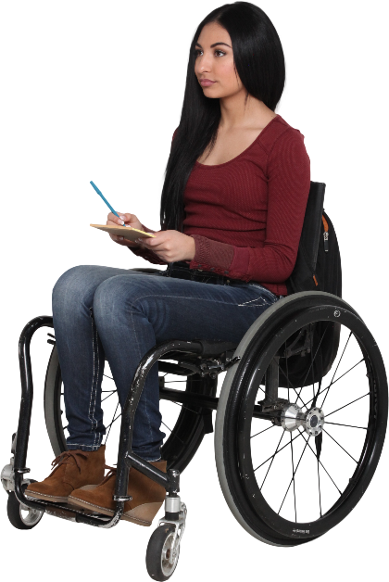
It makes good business sense
16 per cent of the world’s population have a disability. This is over 1.3 billion people.
This global community has an estimated spending power of $13 trillion.
Notes:
It makes good business sense.
Disabled people are the largest minority group in the world. At least 16 per cent or 1.3 billion people in the world have a disability (according to WHO).
Together, with their friends and family, disabled people have a spending power of $13 trillion - yet only 4 per cent of businesses are focused on making offerings inclusive of disability (according to the Global Economics of Disability Report).

Slide 15
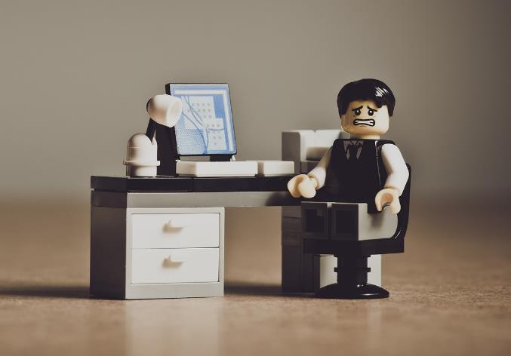
Don’t be the next Domino’s!
Notes:
Don’t be the next Domino’s!
In 2019, the US Supreme Court declined to review the 9th circuit decision on Robles v. Domino’s Pizza.
Robles, a blind man, filed the lawsuit after attempting several times to order pizzas through an inaccessible web site and mobile app. A landmark case that deemed that the ADA applied to web sites and apps in the same way it does to buildings.
This opened up the floodgates to an increase of litigations.

Slide 16
Productivity
Productivity
Accessible solutions boost productivity for everyone.
Notes:
Our fourth theme is productivity.
Accessible solutions boost productivity for everyone.

Slide 17
How does accessibility improve productivity?
Organisations focused on disability are four times more likely to have total shareholder returns that outperform peers.
Notes:
How does accessibility improve productivity?
According to the Accenture report on the Disability Inclusion Advantage, those organisations that are focused on disability are four times more likely to have total shareholder returns that outperform their peer groups. https://www.accenture.com/content/dam/accenture/final/a-com-migration/pdf/pdf-89/accenture-disability-inclusion-research-report.pdf
Accessible solutions work better for everyone. They are easier to navigate, intuitive, simpler and that benefits everyone and improves our productivity. If you’ve ever switched on captions when you’ve not had your headphones to hand, or you’re in a noisy environment, then you’ve used an accessibility feature.
It’s also important that we enable our disabled colleagues by removing any barriers they experience, and providing them with the right adjustments and accommodations to fit their needs.

Slide 18
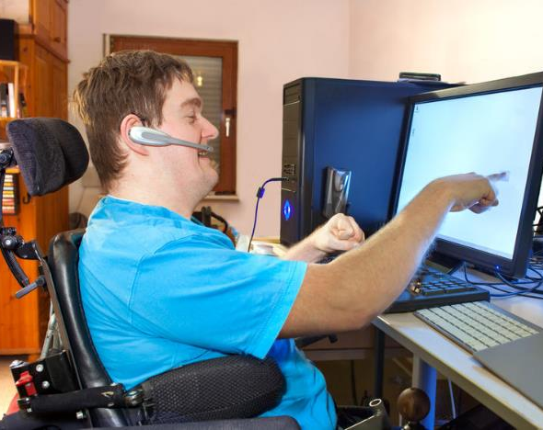
Adjustments/accommodations can be straightforward!
Ask your colleagues what they need and don’t make assumptions!
Adjustments don’t need to be ‘things’ they can be flexible or remote working.
Notes:
Adjustments/accommodations can be straightforward!
Focus on the effect, not the cause.
Just ask your colleagues what adjustments and accommodations they need! They may know already, or you can work with them to support them in finding out what might help – this might be new to them too. It’s important to remember that the adjustments that you make will depend on the individual and their disability – be careful not to make assumptions about what barriers people face, and ensure that you work through solutions with them. “Nothing about us without us”.
You will need to think about the physical space, but also their digital environment and even simple adjustments, such as flexible or remote working. Remember that adjustments don’t need to be ‘things’ (see BDF’s Great Big Workplace Adjustments report). https://businessdisabilityforum.org.uk/the-great-big-workplace-adjustments-survey-2023/.

Slide 19
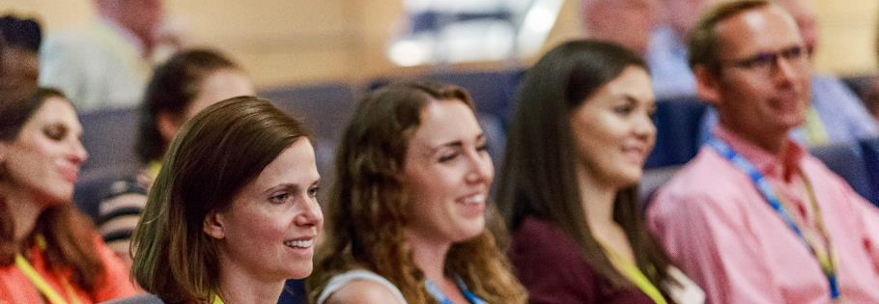
Could these work for non-disabled colleagues?
Notes:
Could these ‘adjustments’ work for non-disabled colleagues?
Many organisations are flipping the narrative on adjustments so that it is talked about in terms of productivity rather than disability.
Yes! We all have times when we want to do things differently, so if flexibility is embedded into an organisation, it will benefit everyone. Assistive technology is essential when it removes barriers for people with disabilities, but it can also benefit your non-disabled colleagues.
For example, mind-mapping can be great for planning or writing long reports, and text-to-speech can be great for catching up with reports and emails while travelling to and from the office, or even for proofreading your work.

Slide 20
What does this have to do with productivity?
53 per cent of employers saw an increase in productivity after adjustments were offered.
42 per cent of employees acquired their disability in their current role.
Notes:
What does this have to do with productivity?
Adjustments boost productivity – and not just for disabled colleagues. We want all our colleagues to be ‘their best self’ and by providing often simple and inexpensive adjustment for them, they can be. A report from the Job Accommodation Network (JAN), which is funded by a contract from the U.S. Department of Labor’s Office of Disability Employment Policy (ODEP), found that 53 per cent of employers saw an increase in employee productivity, and 31 per cent witnessed an improvement in employee safety through providing workplace accommodations. https://askjan.org/topics/costs.cfm
Most adjustments more than repay the cost of implementing them. According to Microlink , the average cost of a fully managed adjustment process was less than £650 per person, with referral rates of between one and four per cent of their workforce annually. If you consider this cost against the costs for recruitment and lack of productivity, these costs are minimal. In BDF’s Big Workplace Adjustments report it states that 42 per cent of respondent with adjustments in place had acquired a disability or condition while working for their current employer – so we aren’t just talking about recruiting disabled talent, we’re talking about retaining your existing talent.

Slide 21
Compliance
Compliance
Raising the bar reduces the risks
Notes:
Our fifth and final theme is compliance.
Raising the bar reduces the risks.

Slide 22
What’s the risk?
100x more costly than building in accessibility at the start. (Deque)
Notes:
What’s the risk?
Deque conducted research based on legal cases and calculated that it can be up to 100 times more expensive to fix accessibility issues after a complaint than building them in from the start.
Too often accessibility is seen as an after thought or not thought about at all. Perhaps more costly still is the impact to your brand.

Slide 23
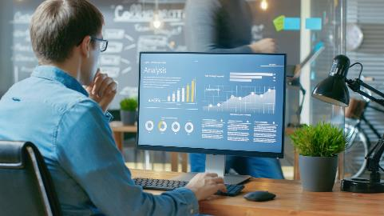
How to reduce the risk
Treat accessibility like information security and privacy:
Build expertise
Plan and be proactive
Apply standards.
Notes:
How to reduce the risk
Treat accessibility like information security and privacy:
- Build expertise by training your staff and bringing in external experts where you have gaps.
- Be strategic and create a plan.
- Apply standards and embed them into your existing processes (WCAG).

Slide 24
Nobody’s complaining, so we are OK, right?
Click-Away Pound research
“If you don’t know it’s accessible it probably isn’t.”
Jenny Lay-Flurrie, Chief Accessibility Officer, Microsoft
Notes:
Nobody’s complaining, so we are OK, right?
The percentage of people who will simply click-away when confronted with a problematic website is 69%, according to The Click Away Pound report http://clickawaypound.com/
“1 in 3 of our FTSE 100 companies still do not have an accessible website” Caroline Casey, Founder of The Valuable 500.
The standards in WCAG are testable and measurable. Use product scorecards – what gets measured gets done.
As Jenny Lay-Flurrie, Chief Accessibility Officer at Microsoft, said: “If you don’t it’s accessible it probably isn’t.”

Slide 25
Five themes of the ABC - recap
Innovation
Inclusion
Brand
Productivity
Compliance
Diverse ideas create new opportunities
Inclusive design leaves no one behind
An inclusive brand outperforms
Accessible solutions boost productivity for everyone
Raising the bar reduces the risks
Notes:
Five themes of the ABC – recap
To recap, the five themes that demonstrate why accessibility is so important are innovation, inclusion, brand, productivity, and compliance.

Slide 26
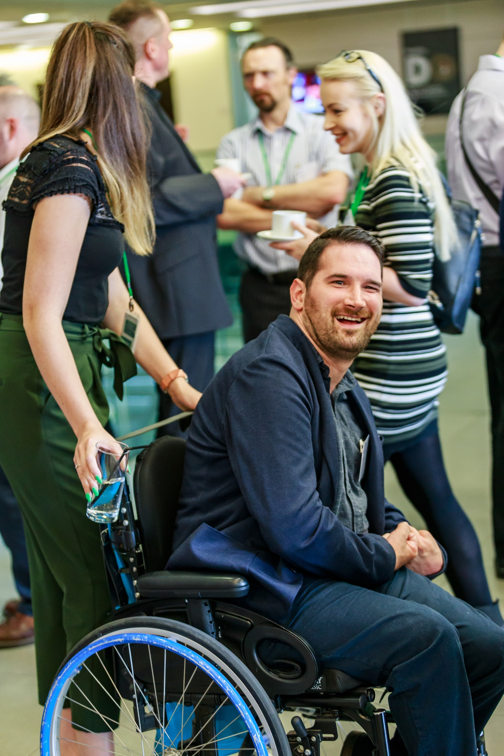
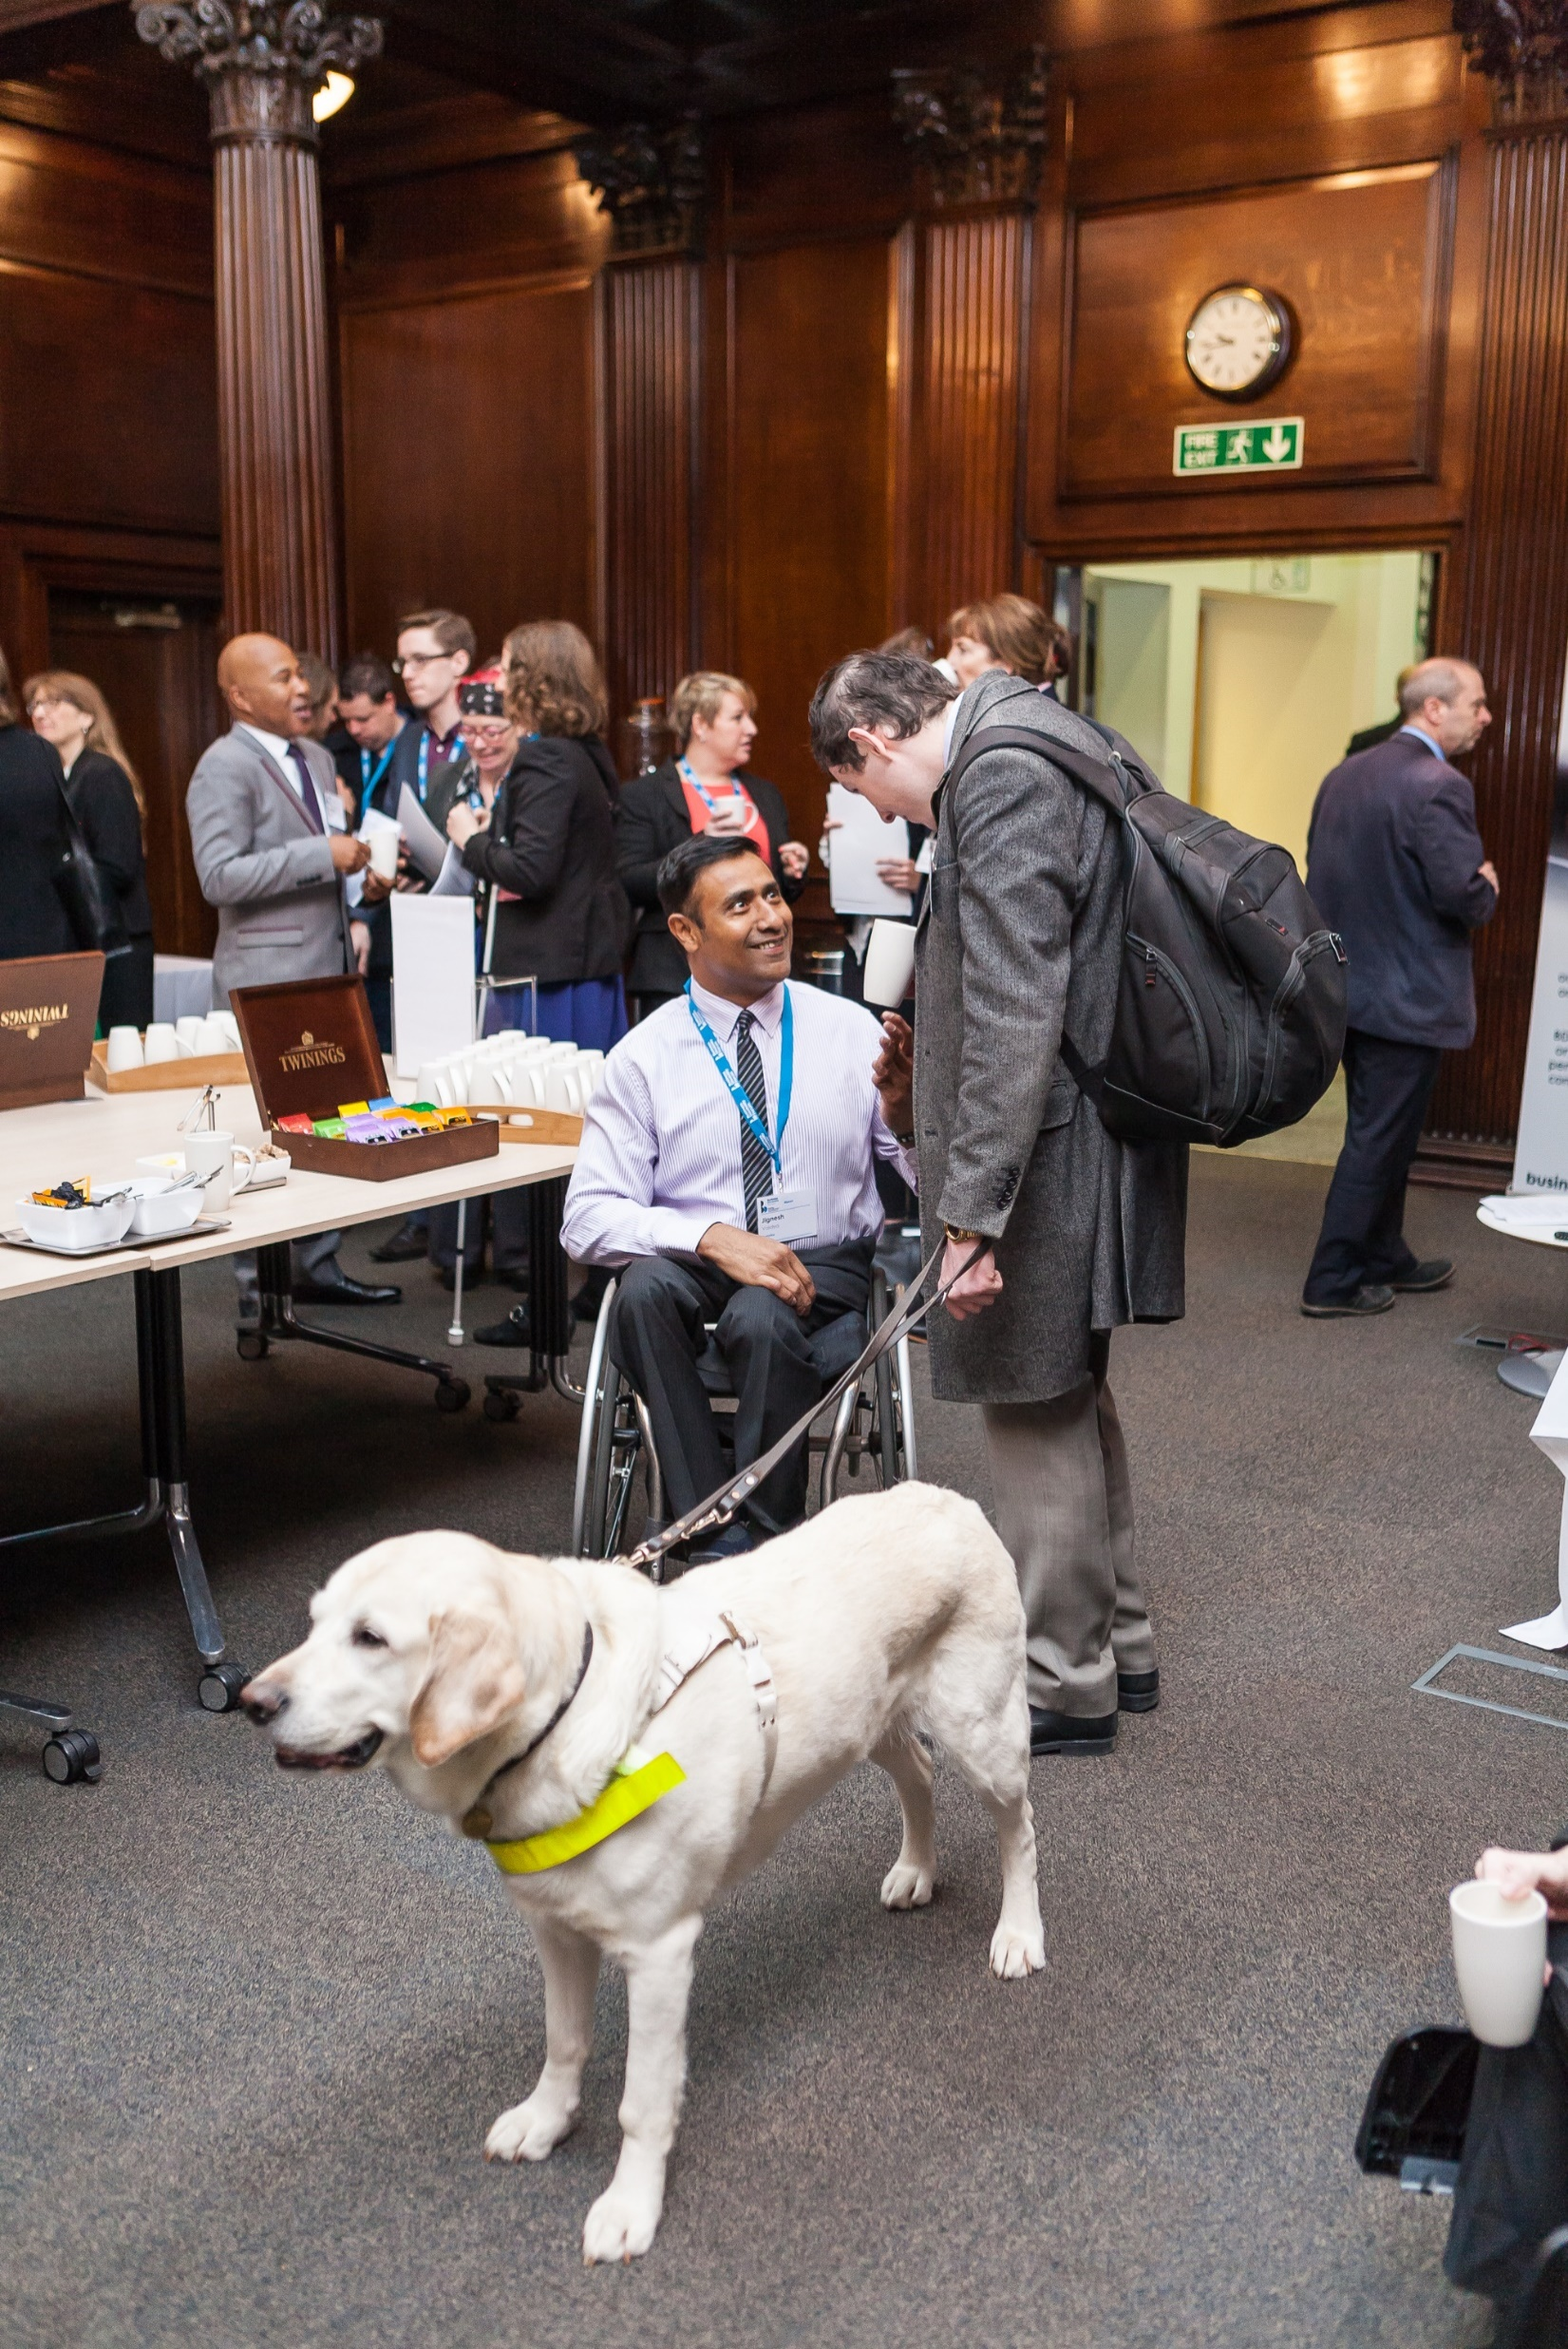
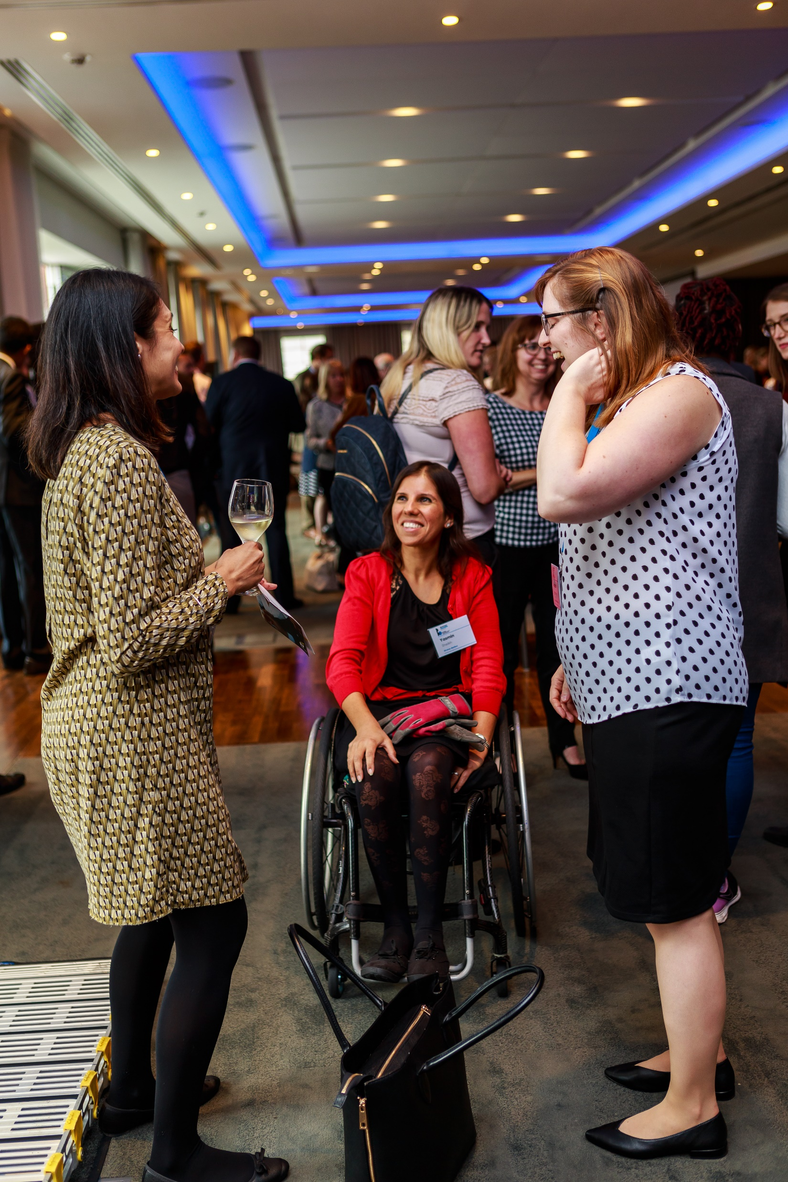
It’s more than just technology….
Notes:
It’s more than just technology
Technology can be the solution, but this is more than technology. This is about people, it’s about you, me, our colleagues, our children, our parents, it’s about everyone and it’s about being included.

Slide 27
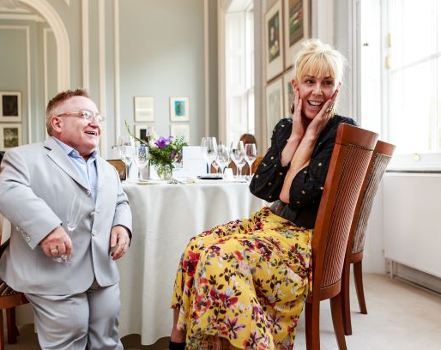
What next?
We’ve discussed the ‘why’. Now, we need to start thinking about the ‘how’.
Notes:
What next?
We’ve discussed the ‘why’. Now, we need to start thinking about the ‘how.’ Talk about how you can make accessibility a reality in your organisation.
There are lots of videos, advice, and free training available on the internet. Also, check out the other resources and guidance on Business Disability Forum’s website and Knowledge Hub.
One of the most effective tools for an organisation, from an accessible technology perspective, is Business Disability Forum’s Accessibility Maturity Model. https://businessdisabilityforum.org.uk/knowledge-hub/resources/tech-taskforce-accessibility-maturity-model/ . This a free resource, available to everyone.

Slide 28
Get in touch
Notes:
Get in touch with Business Disability Forum to find out more.

