Slide 1
Why inclusive communication matters to your organisation

Slide 2
What is inclusive communication?
1 in 5 people in the UK have a disability.
Inclusive communication is a way of communicating that removes barriers that exclude some groups of people, including disabled people.

Slide 3
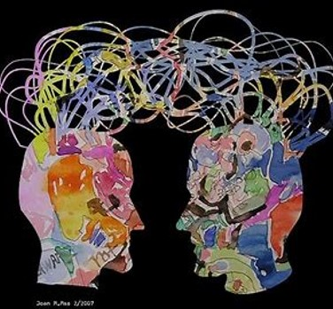
What does this mean for your communications?
Recognising that we all have different communication needs and preferences.
Creating communications that everyone can access, understand, and engage with.

Slide 4
What does this mean (continued)?
Representing and valuing diversity within your communications. Voices, language, and imagery.
Communicating effectively.
Giving people choice over how they receive and communicate information.

Slide 5
Why one view isn’t enough
“Disability covers a wide spectrum and by no means is one view the only view that is relevant or representative.”
Getty Images’ senior director of creative, Rebecca Swift

Slide 6

Why is inclusive communication important for reaching customers?
Inclusive communication:
Increases your audience reach.
Creates better brand awareness and reputation.
Builds customer loyalty.

Slide 7
The customer view
“7 out of 10 people report feeling more positive towards brands that include disabled people in their advertising”.
Source: Getty Images, The Disability Collection, 2019

Slide 8

Why is inclusive communication important to employers?
Inclusive communication:
Shows a clear commitment to accessibility and inclusion.
Attracts in disabled talent.
Increases employee engagement and productivity.
Improves legal compliance.

Slide 9
The candidate view
“When it comes to attracting disabled talent think about where you advertise. Make sure the imagery and language you use reflects disabled people – would a disabled candidate think that your organisation would welcome and support ‘someone like me?’.”
Diane Lightfoot, CEO, Business Disability Forum

Slide 10
Accessible and inclusive communication
Doesn’t make assumptions about how people want to communicate and access information.
Offers a choice of communication channels and formats.
Uses accessible design features to make information more accessible. These include accessible fonts, colour contrast and layout.

Slide 11
Accessible and inclusive communication (continued)
Uses video, audio, and imagery in an accessible way.
Uses plain English.
Represents disabled people in a positive and realistic way.
Works for everyone.

Slide 12
Inclusive Communication Toolkit
Use the resources in the Inclusive Communication Toolkit to make your communications work better for disabled people. These include:
Inclusive Communication and business
Inclusive Communication: Practical resources
Inclusive Communication: Reviewing and developing your organisation’s communications

Slide 13
Get in touch

